Slide 1



Vision in Bad Weather
By S. Nayar & S. Narasimhan
ICCV 1999
a presentation by Pushkar Modi
AI, Robotics and Vision Lab, Dept. of CSE
modi@cs.umn.edu
Shree K. Nayar
Completed his Ph.D. from Carnegie Mellon Univ. in December 1990
Joined Columbia University in January 1991 and is now a Professor
Srinivasa Narasimhan
Completed his Ph.D. in CS from Columbia Univ. in December 2003
Now an Assistant Professor at Carnegie Mellon University

Slide 2
Significance of this study
No escape from bad weather in any outdoor application
Virtually all work in vision is based on the premise that the observer is immersed in a transparent medium (air)
Computer Vision systems must include mechanisms that enable them to function (even if somewhat less reliably) in the presence of haze, fog, rain, snow and hail
Bad weather can be turned to our advantage

Slide 3
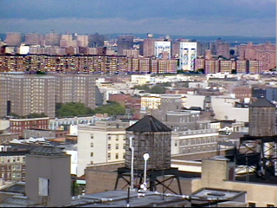
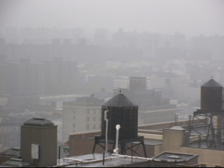
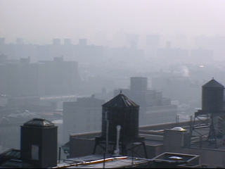
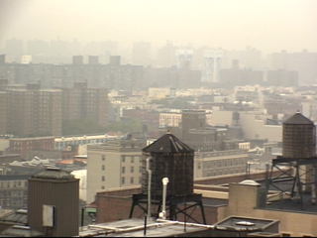
An example
A scene in different weather conditions
Dense Fog
Noon Haze
Clear Day
Rain

Slide 4
Vision and the atmosphere
The physics of light and it’s impact on vision systems
The key characteristics of light, such as intensity and color are altered by the interactions with the atmosphere
Interactions can be broadly classified into Scattering, Absorption and Emission. Scattering due to suspended particles is most pertinent to this study.
The further light has to travel from its source (say, a surface) to its destination (say, a camera), the greater it will be effected by the weather. Hence, bad weather could indicate scene structure.

Slide 5









Atmospheric Optics
The study of the interaction of light with the atmosphere (and hence the weather)
CONDITION PARTICLE TYPE RADIUS (μm) CONCENTRATION (cm )
-3
AIR
HAZE
FOG
CLOUD
RAIN
Molecule
Aerosol
Water Droplet
Water Droplet
Water Drop
( McCartney, 1976 )

Slide 6

Mechanisms of Atmospheric Scattering
Changes in scattering due to particle type
The manner in which a particle scatters incident light depends on its material properties, shape and size
The exact scattering function is closely related to the ratio of particle size to wavelength of incident light.
A particle in the path of an incident light wave abstracts and reradiates incident energy. It therefore behaves like a point source of light.
Incident Beam
Size: 0.01
Size: 0.1
Size: 1

Slide 7
Mechanisms of Atmospheric Scattering
Significant phenomenon's
Attenuation - The radiance of a scene point falls as its depth from the observer increases.
Airlight - A second mechanism causes the atmosphere to behave like a source of light due to scattering of environmental illumination by particles in the atmosphere. The environmental illumination can have several sources, including, direct sunlight, diffuse skylight and light reflected by the ground.
Airlight increases with path length and therefore causes the apparent brightness of a scene point to increase with depth.

Slide 8
Structure from airlight
An example of how we can benefit from bad weather
When we have fog, attenuation of object brightness is severe and airlight is the main cause of image irradiance.
Also, in the case of dense haze around noon, most visible scene points are not illuminated and airlight dominates. In both cases, airlight causes object brightness to increase with distance from the observer.
Thus, the brightest point in an outdoor scene is assumed to be the horizon. By using the relative intensities of the points in a single image, the relative depth of objects can be obtained.

Slide 9
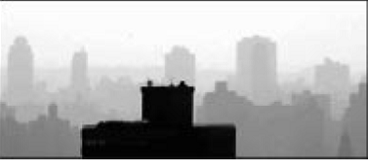
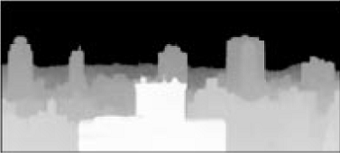
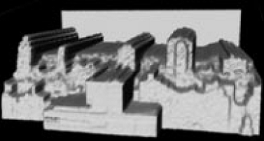
Structure from airlight
An example of how we can benefit from bad weather

Slide 10
References
S. Nayar, S. Narasimhan, Vision in Bad Weather, ICCV, Vol.2, pp.820-827 1999
http://www1.cs.columbia.edu/CAVE/projects/vision_fog/

